Slide 1

Accelerometer Types
Common Accelerometer Types
  Resistive
    Strain Gauge
    Piezoresistive
    Micromachined
    Thin-Film
  Capacitive
  Fiber Optic
  Servo or Force Balance
  Vibrating Quartz
  Piezoelectric

Slide 2
Accelerometer Types
Resistive Operating Principle
  Voltage output of resistor bridge changes proportionally with applied acceleration
+ Signal
+ Power
- Power
- Signal
Fixed Resistors
Sensing Resistor #1
Flexure
Sensing Resistor #2
Mass

Slide 3
Accelerometer Types
Capacitive Operating Principle
  Utilizes frequency modulation technique through varying capacitor bridge
Power
Ground
Signal
Fixed Capacitors
~
Built-In Electronics
Insulator
Sensing Capacitor #1
Flexure
Mass
Sensing Capacitor #2
Insulator

Slide 4
Accelerometer Types
Resistive / Capacitive
  Typical Characteristics
    Measure down to 0 Hz (DC response)
    Limited dynamic range (<80 dB = 10,000:1)
    Limited high frequency range (<10 kHz)
    Often a damped frequency response (0.7% of critical)
    Sensitivity may vary with input (mV/g/V)
    Traditionally fragile (limited shock protection)
    Operates multi-conductor cable (at least 3 wires)
    Micro-machined versions are small and lightweight
    Performance matches cost ($10 to $1000 USD)

Slide 5
Accelerometer Types
Resistive / Capacitive
  Applications
    Low frequency and/or long duration events
      Ride quality
        Automobile road response
        Amusement park rides
        Elevator movement
        Motion simulators
      Aerospace structure modal analysis surveys
      Crash dummy instrumentation
    Tilt sensors
    Airbag or automobile alarm triggering devices

Slide 6

Accelerometer Types
Fiber Optic Operating Principle
  Amount of light gathered by receivers is proportional to applied acceleration
Power
Ground
Signal
Built-In Electronics
Transmitter
Receiver
Receiver
Reflective Surface
Flexure
Mass
Flexure

Slide 7
Accelerometer Types
Fiber Optic
  Similar characteristics and applications as resistive and capacitive sensors
  Additional features
    Provision for remotely locating electronics
      High temperature operation to 1000 F (537 C)
      Cabling is transmitting only light, which consequently eliminates the possibility of RF and EM interference in “noisy” environments
      Traditionally, light loss in long cables and connections was a consideration
      Expensive sensors, cabling and signal conditioning

Slide 8
Accelerometer Types
Servo or Force Balance Operating Principle
  Feedback force required to maintain uniform capacitance is proportional to acceleration
Power
Ground
Signal
Sensing Amplifier
Feedback Power Amplifier
Stationary Support
Capacitance Gap
Flexure
Coil
Magnetic
Mass
Insulator

Slide 9
Accelerometer Types
Vibrating Quartz
  Resonant frequency difference between elements is proportional to applied acceleration
Power
Ground
Signal
Inverting Amplifier
Frequency Tracking Amplifiers
Flexure
Mass
Vibrating Crystal #2
Vibrating Crystal #1
Mass
Flexure

Slide 10
Accelerometer Types
Force Balance / Vibrating Quartz
  Typical Characteristics
    Measure down to 0 Hz (DC response)
    Wide dynamic range (>120 dB = 1,000,000:1)
    Extremely stable over time and temperature (ppm)
    Limited high frequency range (<1 kHz)
    Poor overload survivability (<100 g’s)
    Force balance may exhibit large magnetic sensitivity
    Very expensive (~$1000 USD)

Slide 11
Accelerometer Types
Piezoelectric
  Force on self-generating crystal provides charge output proportional to acceleration
Signal/Power
Ground
Voltage or Charge Amplifier
Preload Ring
Mass
Piezoelectric Crystal
Base

Slide 12
Piezoelectric Materials
Piezoelectric Effect
  Word origin comes from the greek work “piezen” which translates “to squeeze”.
  The generation of an electrical signal by a dielectric material as it is subjected to a mechanical stress.
F
+
+
+
+
+
+
+
Piezoelectric Material
-
-
-
-
-
-
-
F

Slide 13
Piezoelectric Materials
Piezoelectric Materials
  Naturally Piezoelectric
    Rochelle Salt
      One of first materials used to make sensors
    Tourmaline
      Sensitive to hydrostatic pressure
    Exotic, “Man-Made” Materials
      Langasite
      Lithium Niobate
    Cultured Quartz

Slide 14
Piezoelectric Materials
Piezoelectric Materials
  Artificially Polarized
    Piezofilm
      Made of a special polymer - PVDF
    Piezoceramics
      Lead Zirconate Titanate (PZT)
      Bismuth Titanate

Slide 15
Mechanical Design
Piezoelectric Sensing Element
  Mechanical transduction mechanism as important as piezoelectric material selection
  The key is to design the sensor so that it only measures the parameter of interest and minimizes the affects of any outside environmental conditions
  Types
    Compression Mode
    Flexural Mode
    Shear Mode

Slide 16
Mechanical Design
Shear Mode
  Most commonly utilized design based on overall performance
+
+
+
+
-
-
-
-
-
-
-
-
+
+
+
+
Seismic
Mass
Preload Ring
Piezoelectric
Crystal
(d₂₆-Quartz)
(d₁₅-Piezoceramic)
Center
Post
Signal (+)
Ground (-)
Optional Built-In
Electronics

Slide 17
Accelerometer Types
Piezoelectric
  Typical Characteristics
    Dynamic events only (>0.2 Hz)
    Wide dynamic range (>100dB = 100,000:1)
    Wide frequency bandwidth (<1 Hz to >10 kHz)
    Solid-state (No moving parts)
    Self-generating piezoelectric elements require no power
    Operates over two conductors
    Rugged (5,000 g’s)
    High temperature charge versions operate to 1000 F (537 C)

Slide 18
Accelerometer Types
Summary
  Many different types of accelerometers are available and they often represent an excellent choice for making vibration measurements; however, accelerometers are not well-suited for all applications as no single sensor can meet every vibration requirement.
  Don’t underestimate the sensor selection process as it is easy to generate “bad data” without the proper transducer.

Slide 19
Calibration Methods
Absolute Method
  Single channel test where the sensor is subjected to a known, accurate and reliable measure of “a”
    Drop Test
    Gravity Inversion Test
    Handheld Shaker
Known Measure of “a”
Test Sensor
Amplifier, Attenuator, Filter, Etc...
Voltmeter, Analyzer, Scope, Etc...

Slide 20
Calibration Methods
Drop Test
  Accelerometer is allowed to free-fall in Earth’s gravity which varies by less than +/-0.5% around the globe
Impact Force
Fixed Supports
Elastic Suspension Cords
Flexible Monofilament Line
Mounting Mass
Earth’s Gravity
0 Deg Latitude: 9.78 m/s²
90 Deg Latitude: 9.32 m/s²
Altitude Correction: -3 mm/s² per 1000 m above sea level
Signal Out
Accelerometer

Slide 21
Calibration Methods
Gravity Inversion Test
  Sensor is rotated 180 Degrees in the Earth’s gravity so that it experiences a 2g (-1 g to +1 g) step function
    Requires long DTC or DC response for accurate results
    Signal Conditioning and readout device must be DC coupled
Rotation Fixture
Test Sensor

Slide 22
Calibration Methods
Relative Method
  Dual channel test where the test sensor and calibrated reference are subjected to the identical input acceleration. The ratio of the output signals provides the calibration factor.
    Laser Fringe Counting (Primary Method)
    Back-to-Back Calibration (Secondary Method)
Test Sensor
Amplifier, Attenuator, Filter, Etc...
Input Signal
Voltmeter, Analyzer, Scope, Etc...
Reference Sensor
Amplifier, Attenuator, Filter, Etc...

Slide 23
Calibration Methods
Laser Calibration
  Non-contacting measurement principle
    Structure not affected by measurement device
  Utilizes “fringe counting” of laser light
    This method provides primary calibration as it is based on a constant on nature…the wavelength of light
  Expensive
  Requires relatively large accelerations at high frequencies
    25 g’s at 5 kHz; 50 g’s at 10 kHz; 100 g’s at 20 kHz
  Procedure and set-up is documented in approved ISO Standard ISO 5347-1

Slide 24
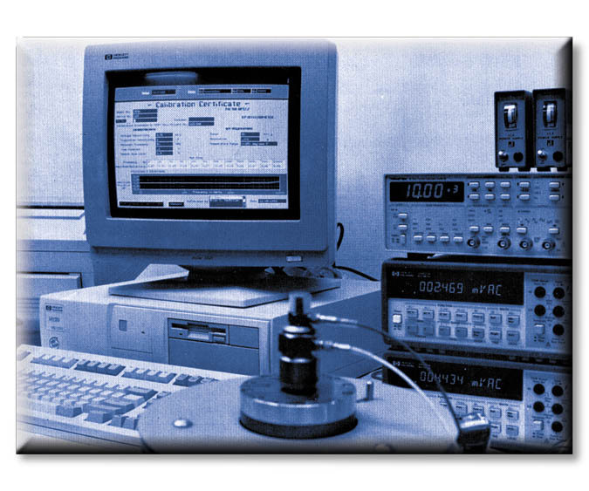
Calibration Methods
Back-To-Back Calibration
  Test sensor mounts directly to a reference accelerometer which has been previously calibrated by primary means or by a recognized laboratory
Test
Accelerometer
V_{test}
V_{ref}
Reference Accelerometer
Instrument
Grade Shaker
Controllable Acceleration Level

